Slide 1
Bitcoin trading system -mavericks
Preetam Jain
Rupesh Acharya
Niyati Maheshwari

Slide 2
PROBLEM STATEMENT
The focus is on using and encouraging the widespread usage of digital currency to a level equivalent to paper currency transactions in our day-to-day life such as in e-commerce platform, Hospitals, malls, etc.
The application will demonstrate the trade of bitcoins among different investors via custodian organization and miner organization.
Also, the application supports the online shopping of products through a bitcoin mall which accepts the payments in bitcoins only.
To achieve the interaction of different networks, enterprises and organizations via usage of the trending technology called “Blockchain Technology”.
To combine ideas of bitcoin usage in e-commerce industry and healthcare industry keeping the total Eco-system design as a reference.

Slide 3
Description
The project is a Bitcoin trading ecosystem simulating blockchain technology, where every enterprise in the system will communicate with the Bitcoin Exchange enterprise.
The system is pushed down to organizational level trading, where every organization in the environment can trade through bitcoins at enterprise and network level too.
The application can be useful for everyone especially those who find trading in bitcoins difficult and also the purpose of bringing the bitcoin into existence in our daily lives will be served well.
Using the special features of cryptocurrency like authenticity, scalability and no central authority involved in the transactions, the trading system becomes more secure and also easier to transact.

Slide 4
APPROACH - i
Bitcoin trading among different investors is made easy by introducing a Custodian Organization which acts as a medium/interface between clients and the miners.
This being a cryptocurrency project, in the absence of a central authority, all the transactions are withheld in an intermediary called as Mempool which is a network of computers and devices connected to the internet running the Bitcoin core software.
All the transactions in the System design wait inside the Mempool until a member/group of the Miner Organization called ‘Miners’ confirm them.
To confirm a transaction, a Miner has to solve a math puzzle of a difficulty level varying on the number of blocks that have been mined.
If a Miner is able to solve the puzzle, then he can add those confirmed transactions into a block.

Slide 5
APPROACH - ii
These blocks are then published into a chain of blocks called as ‘Ledger’ – which is nothing but a single and common record of all the bitcoin transactions; and hence the name “Blockchain Technology”.
Bitcoin mall’s operations include all those operations of any e-commerce industry and the transactions here are purely bitcoin based.
We have incorporated the bitcoin transaction system into healthcare industry as well where the financial exchanges of daily test requests from a doctor to a lab assistant are demonstrated through bitcoin blockchain.
The idea behind the amalgamation of blockchain and healthcare industry is that the reports will be decentralized and be accessible to a doctors anywhere across the world.

Slide 6
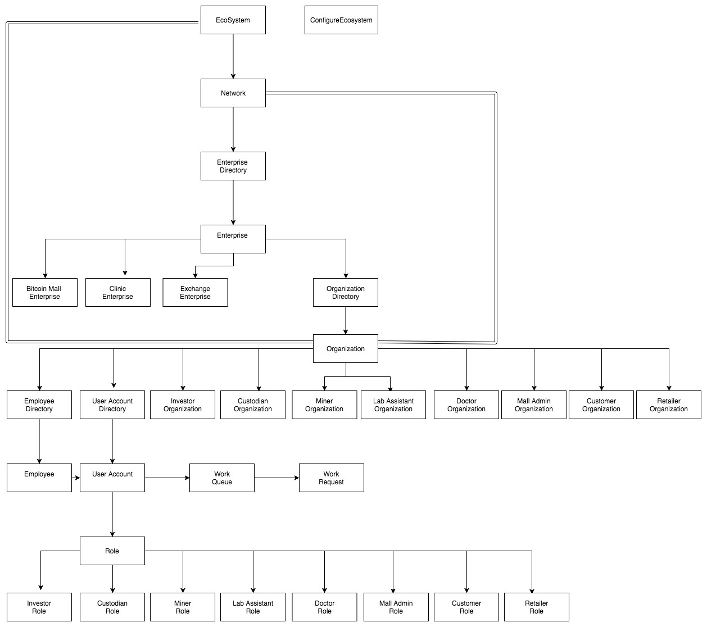
ECOSYSTEM ARCHITECTURE

Slide 7
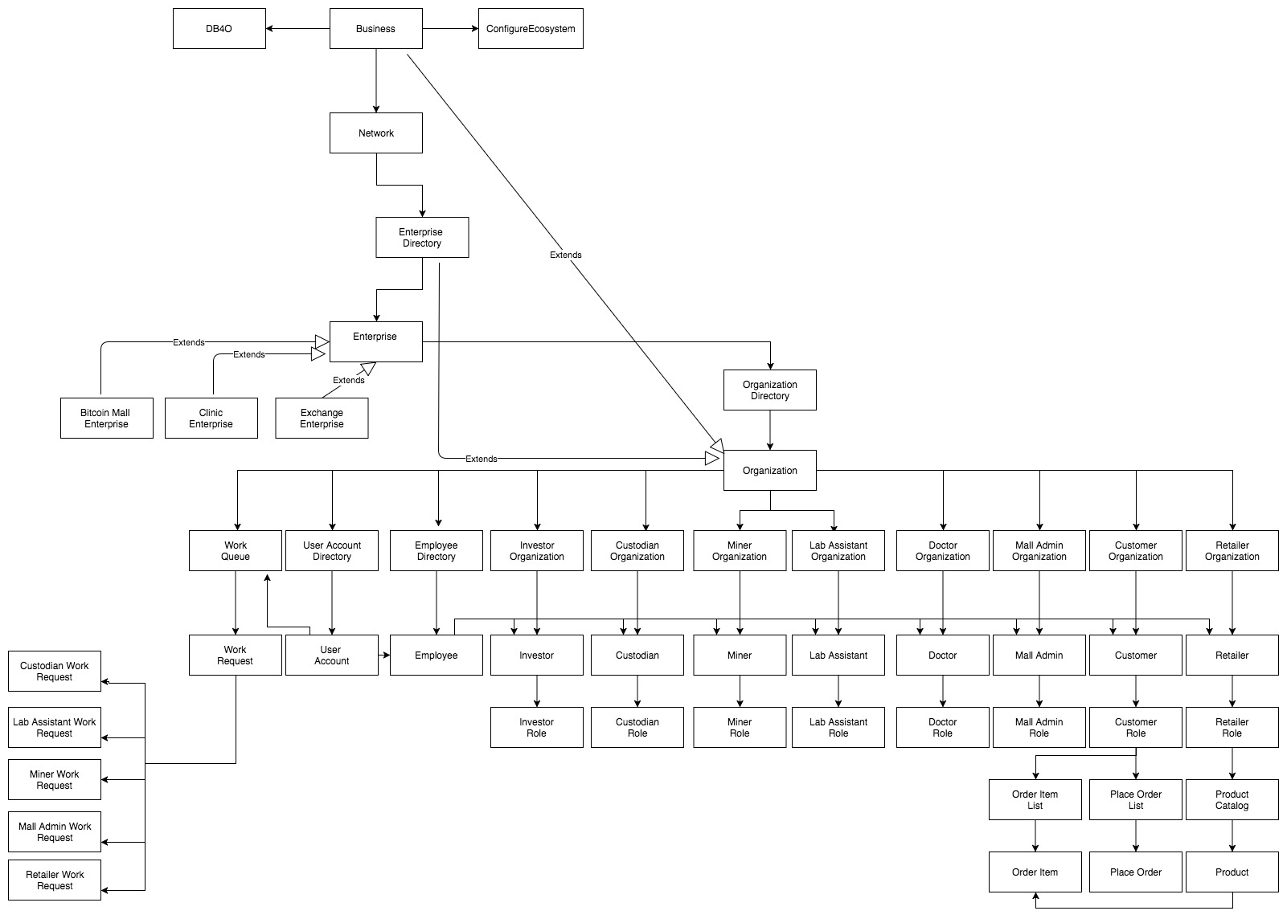
OBJECT MODEL

Slide 8
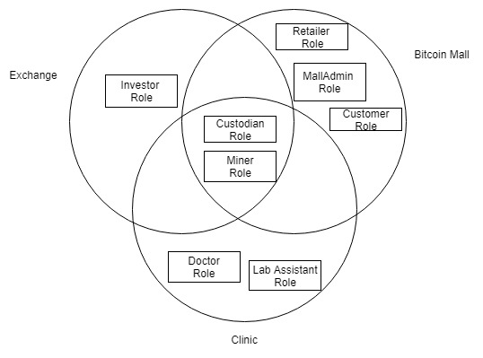
KEY ROLES
SHARED ROLES
Custodian Role : Processes and completes
the input requests received from Investor
- Miner Role : Validates and confirms the list
of unconfirmed transactions received from
the Custodian and publishes those transaction
blocks into a ledger.
OTHER ROLES
Investor Role : Invests money to carry out bitcoin trading
through a custodian.

Slide 9
ACTORS & USE CASES
System Administrator: Administrator responsible for creating and managing networks
Mall Administrator: Administrator responsible for creating and managing customers and retailers in a Bitcoin mall
Retailer: Supplies products to customers of Bitcoin mall
Customer: End user who orders products from Bitcoin mall
Doctor: Requests Lab Assistant to carry out medical tests
Lab Assistant: Carries out tests and generates report of the tests requested by the doctor

Slide 10
SPECIAL FEATURES
Sending SMS on sign up of a new user
Email system on registering a user
Create and Email Interactive Charts to users of the application
Report Analysis of the exchanged data
Download report and export to csv format
Email report to the respective users
Generating a math puzzle for a transaction to be confirmed by Miners
Well maintained ledger with bitcoin ownership exchange details
Total Eco-System design

Slide 11
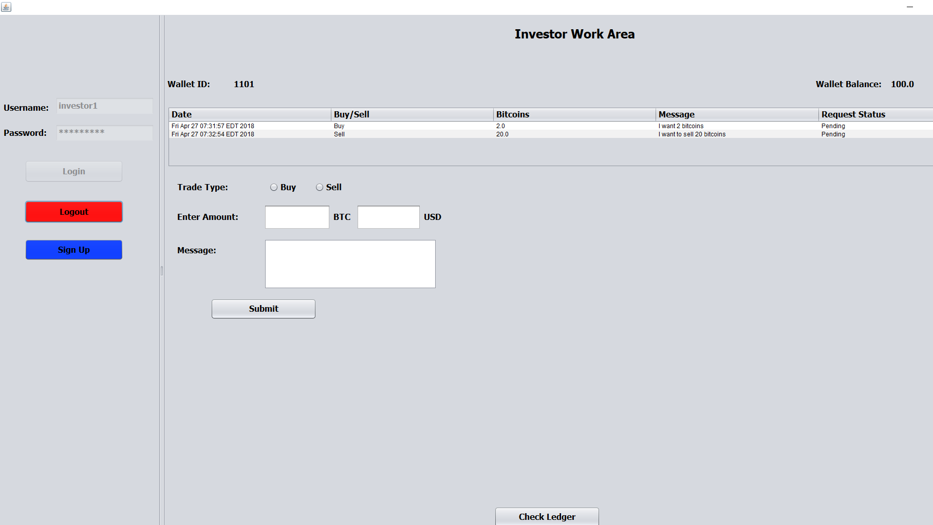
SCREENSHOTS – Key Screens of the system

Slide 12
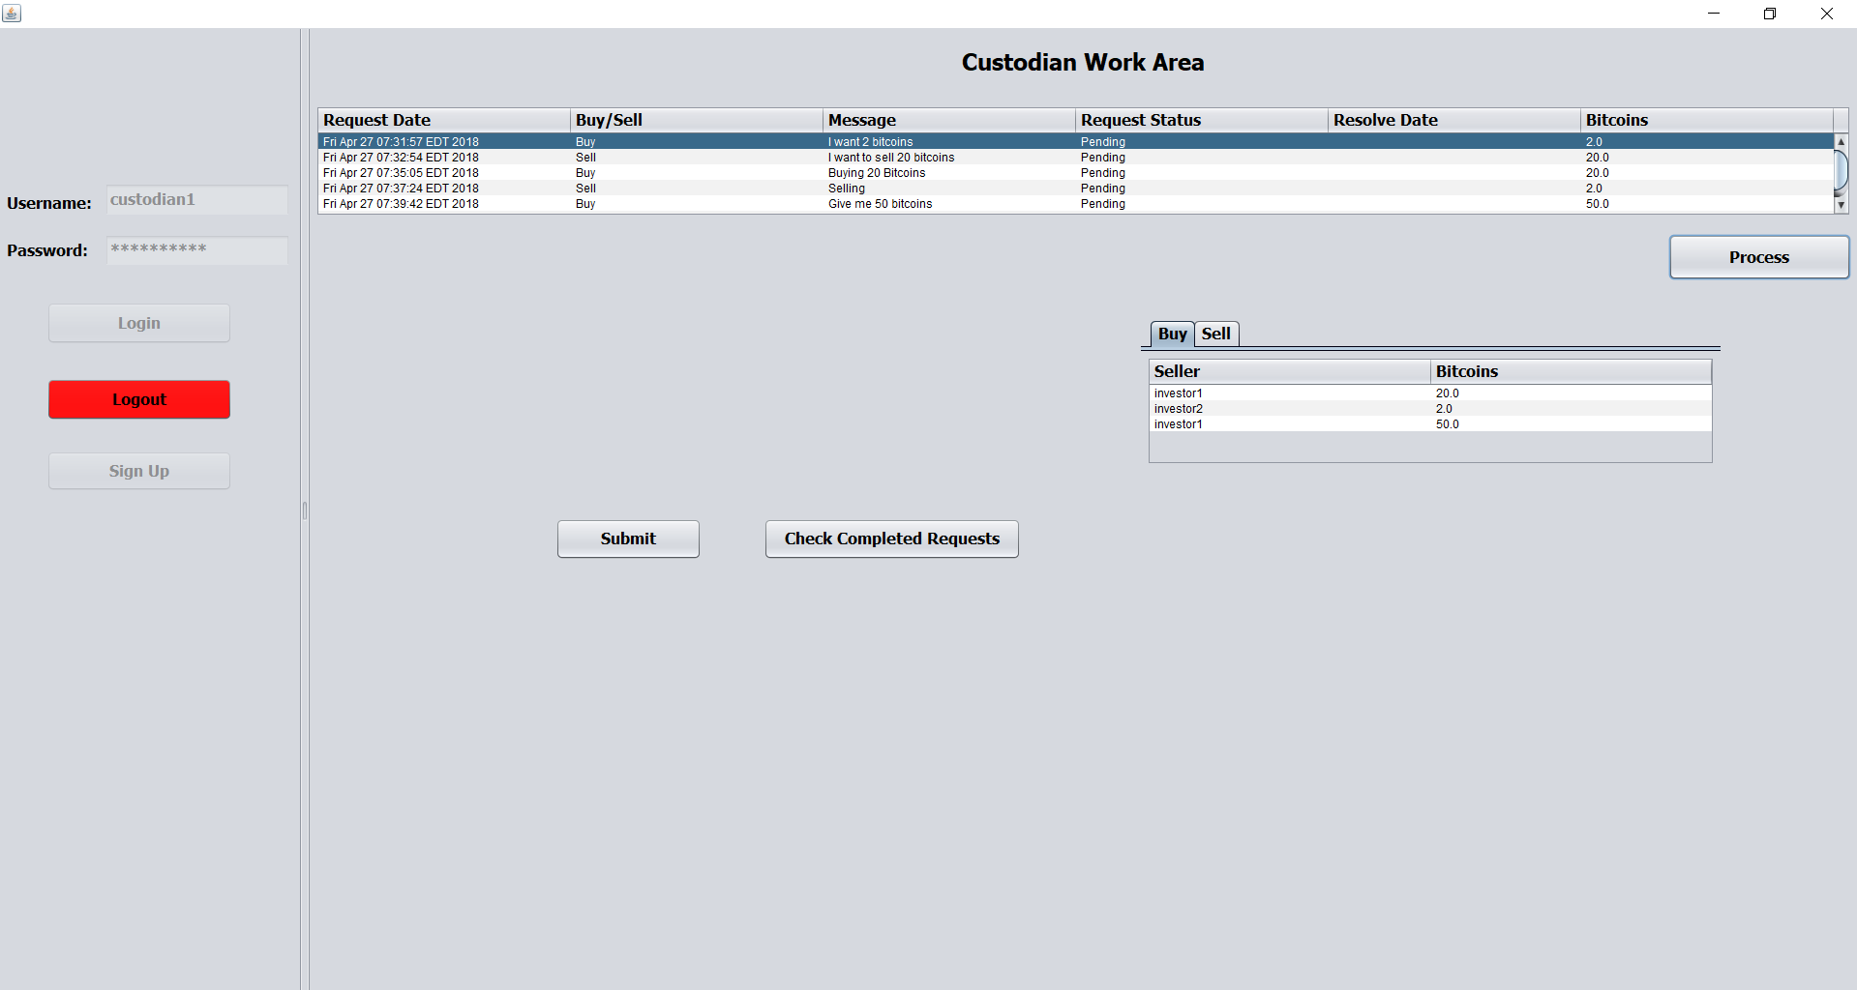

Slide 13
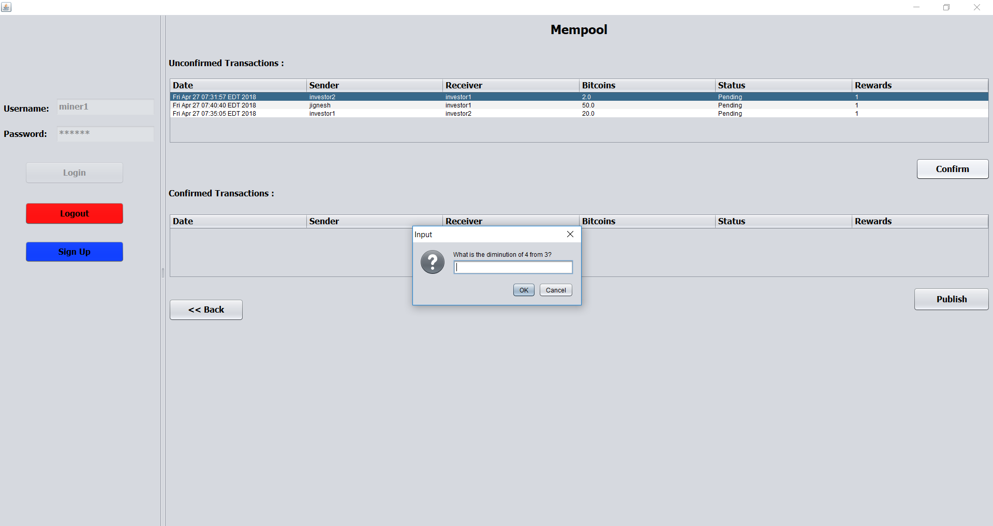

Slide 14
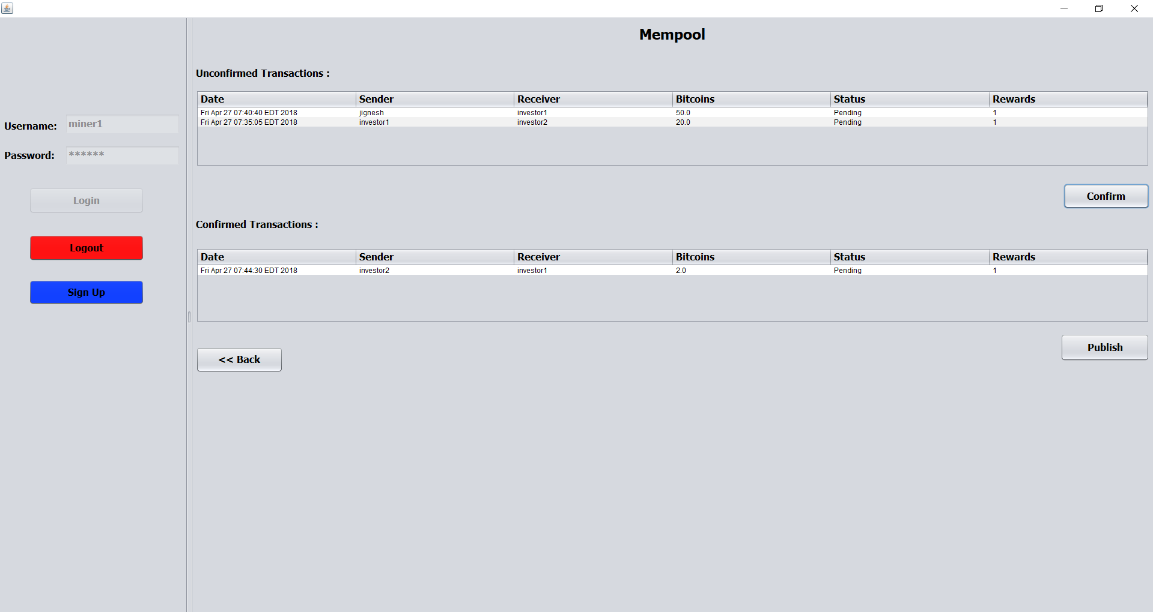

Slide 15
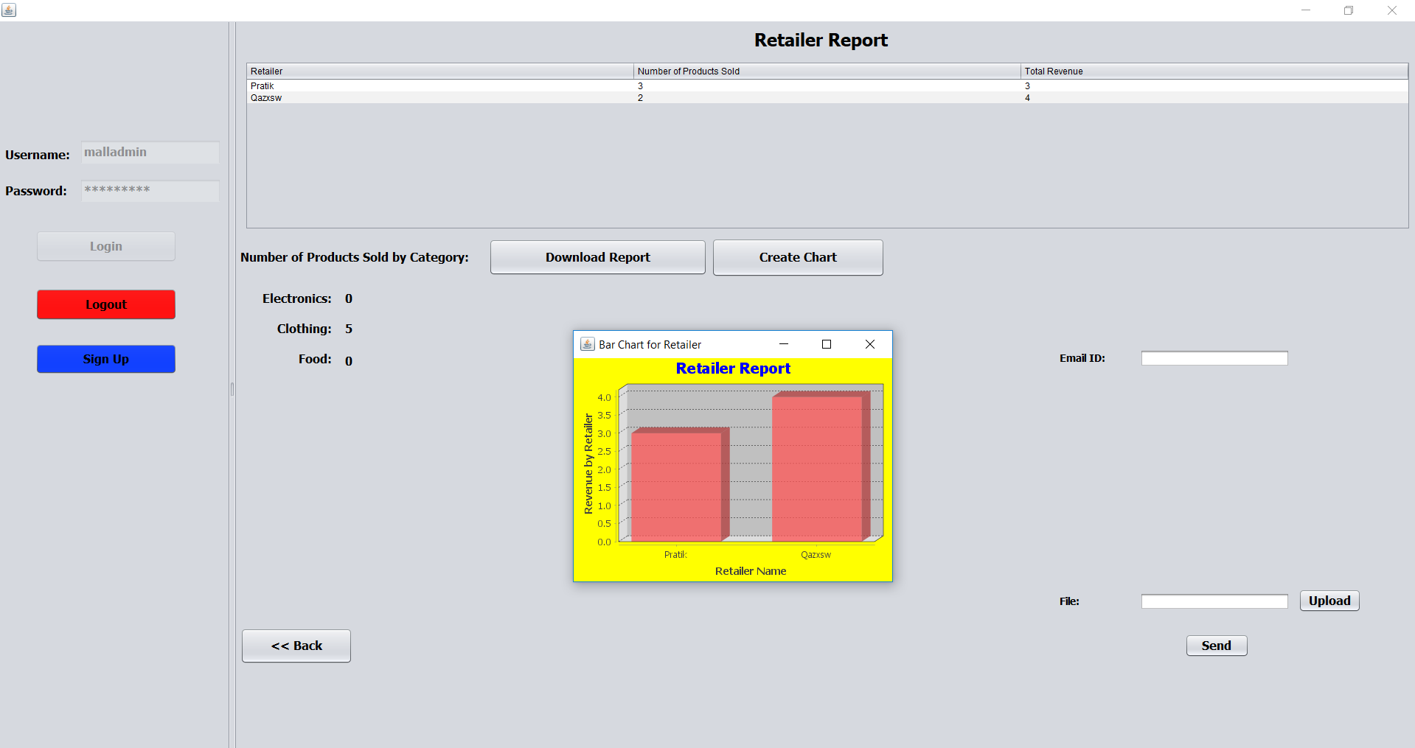

Slide 16
THANK YOU

